Slide 1
ITCS 6112: Software System Design and Implementation
Coattails
Group #1: Ara Chung, Abdullah Azihan, Chia Omotosho, Gavin Sidhu, Desmond Williams

Slide 2

Project Scenarios
visualize, analyze, predict, recommend
User: interested everyday person, active intermediate trader and the stocks expert.
Coattails: a dynamic tool for investment learning
users view verified financial data in an easily digestible way
users save this information and later reference
users informed for wiser decision making
Subject: the financial investment data of politicians,
may later incorporate other public portfolios
Notes:
Overall what are we trying to solve
The goal is to be resource for a variety of people interacting with stocks, trades and financial investing
User: interested everyday person, active intermediate trader and the stocks expert.
Coattails: a dynamic tool for investment learning.
users view verified financial data in an easily digestible way
users save this information and later reference
users informed for wiser decision making
Subject: the financial investment data of politicians,
may later incorporate other public portfolios

Slide 3
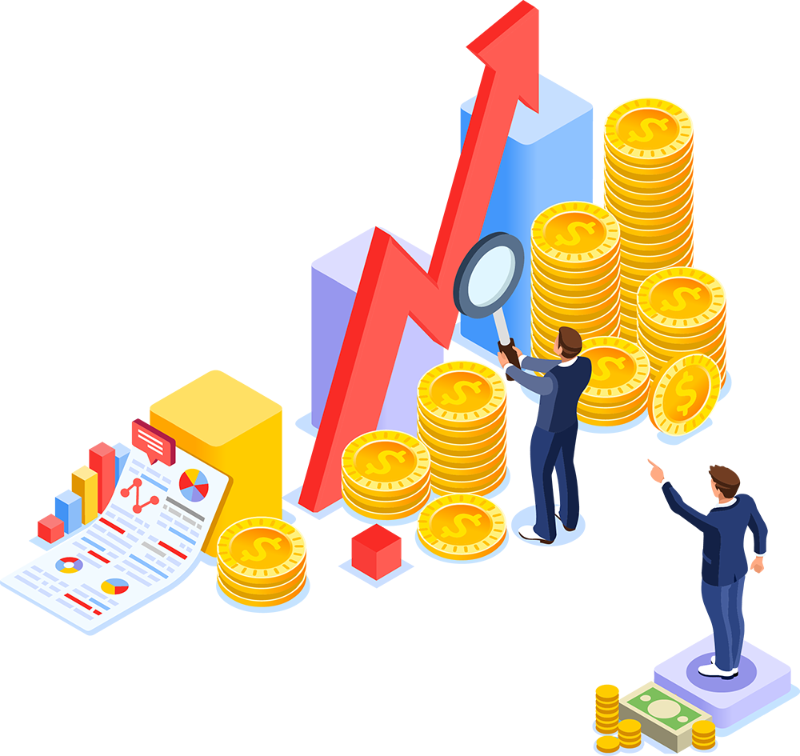
Coattails Proposal
Coattails : web application with various features for analysis and visualization of investment data
Focus of the analysis is on the financial portfolios of US Congress and the details of their assets and transactions
Features include: User Profiles, Interactive Charts, Search Queries, Informative Statements
Notes:
As stated Coattails is a financial investment tool
In the form of a web application with various features for analysis and visualization of investment data
focus of the analysis is on the financial portfolios of US Congress and the details of their assets and transcations
Features: User Profiles, Interactive Charts, Search queries, Informative Statements

Slide 4
Why we choose it & Problem of interest
We chose this because we had always heard about US politicians being involved in insider trading and that they had the best stock portfolios, so we wanted to use publicly available data to see how closely politician investments aligned with actual stock performances to see if these advantages could be passed on to the average investor.

Slide 5
Context
An investment portfolio is a collection of financial investments like stocks, bonds, commodities, cash, and cash equivalents, including closed-end funds and exchange traded funds (ETFs). People generally believe that stocks, bonds, and cash comprise the core of a portfolio.
A ticker symbol is a unique series of letters assigned to a security for trading purposes
A time series tracks the movement of the chosen data points, in this case details of congress’s financial investment transactions over a specified period of time.
(investopedia)

Slide 6
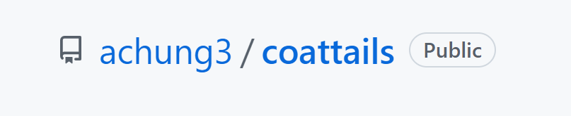
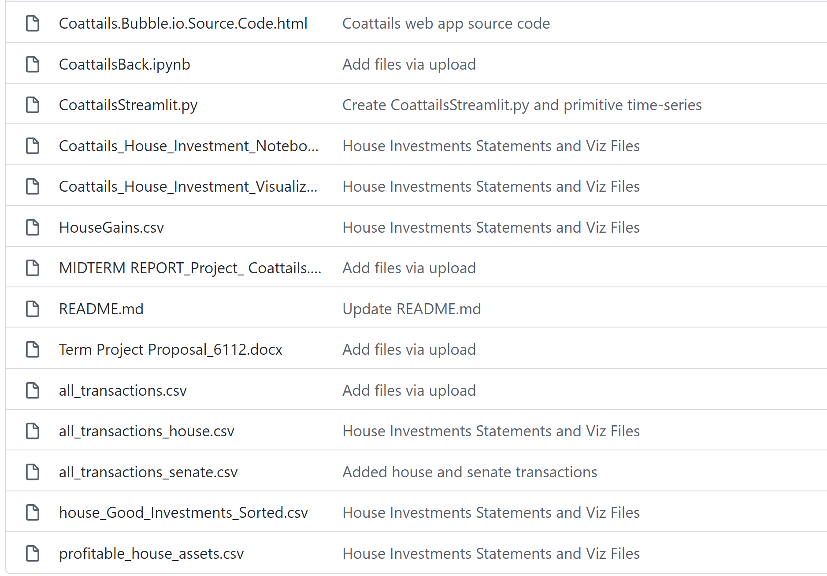
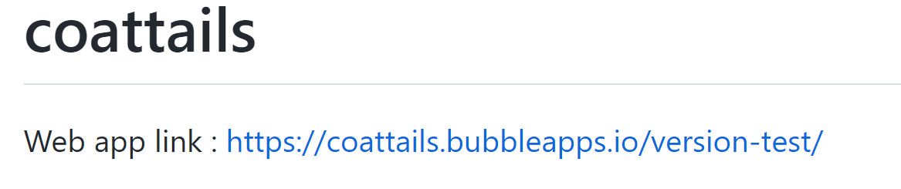
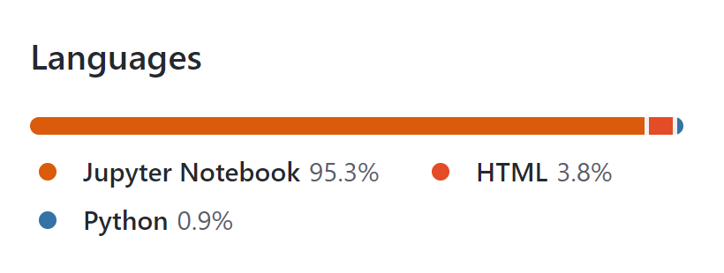
How we did it

Slide 7

Struggles
C: Cohesive outline
A: Assign tasks
S: Start earlier
H: Having solid goals

Slide 8
Future Features
Launch a website that is integrated with all our components
Implement security features
Partner with trading companies
Increase the scope of our data

Slide 9
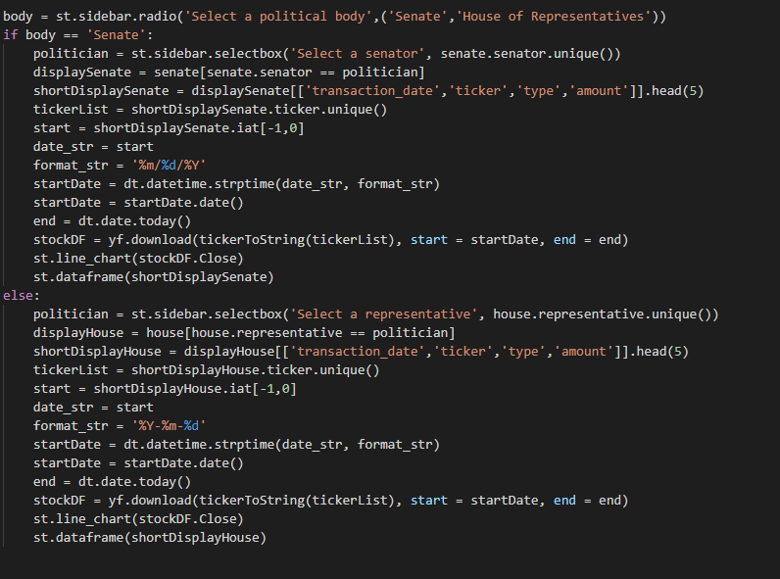
Code

Slide 10
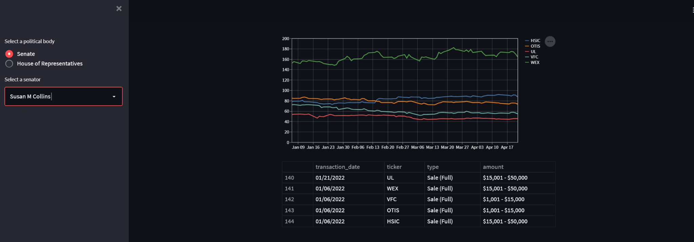
Demo

Slide 11
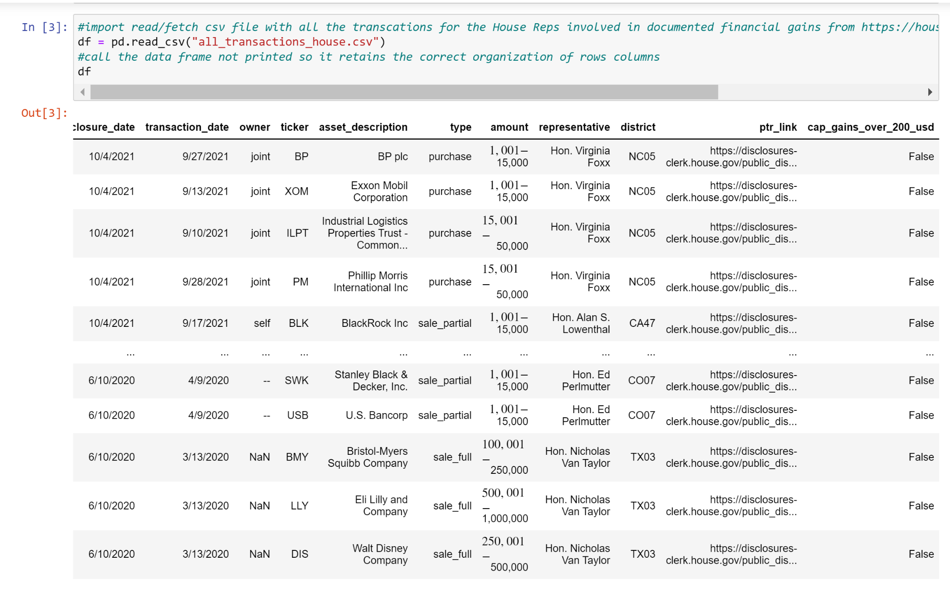
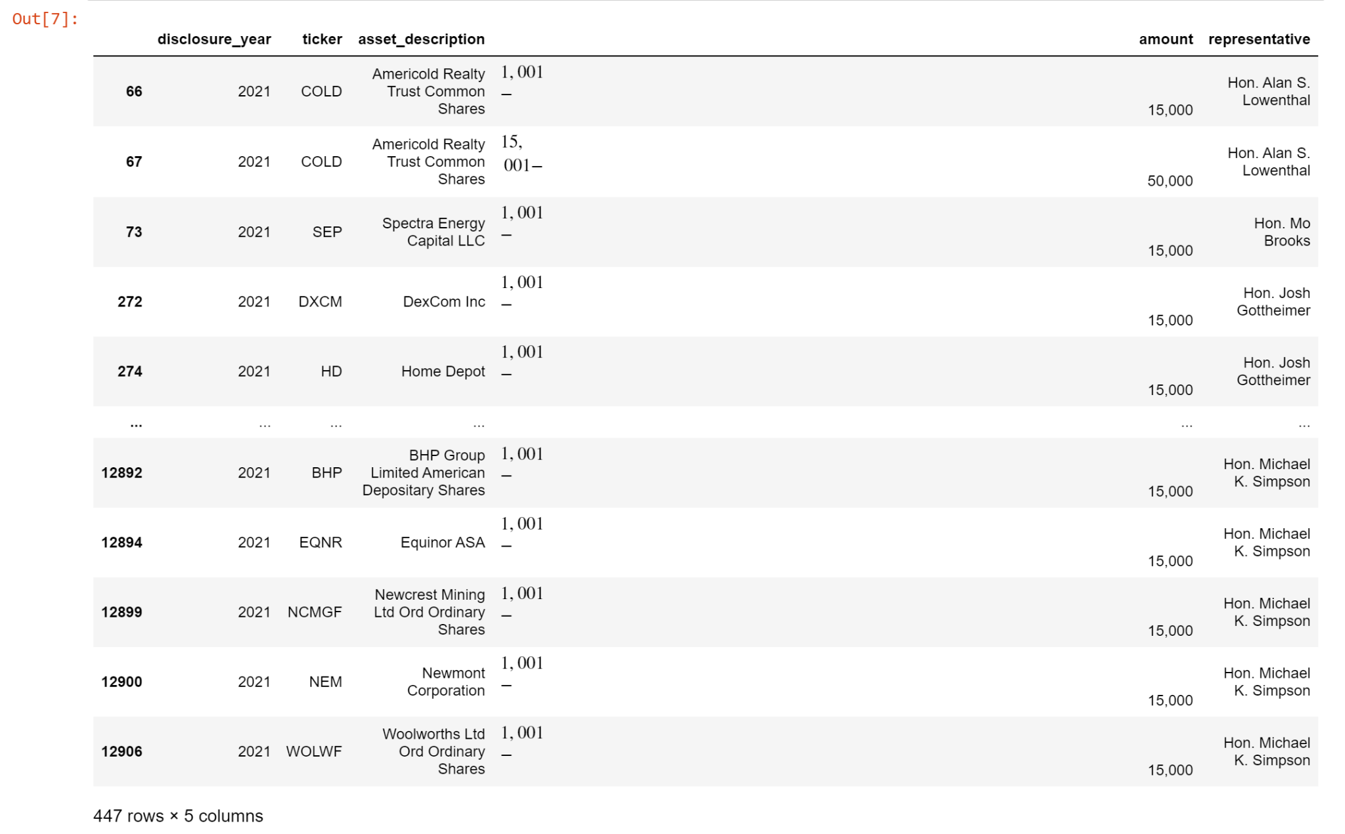
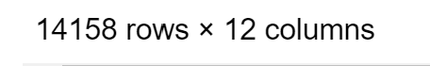
Code Data Mining for House Investments Features
all_transactions_house.csv
HouseGains.csv
Notes:
From investigating the Politicians portfolio we can then look generally at the specific assets they invested in within a larger group but same context
Goal to refine data from stockwatcher api’s downloaded as csv’s
The incorporated data is of the house of representatives published financial disclosures

Slide 12
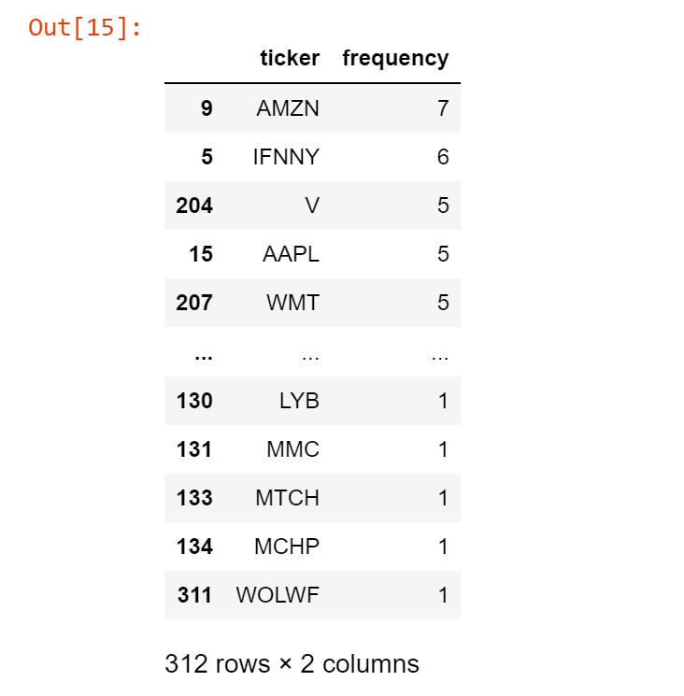
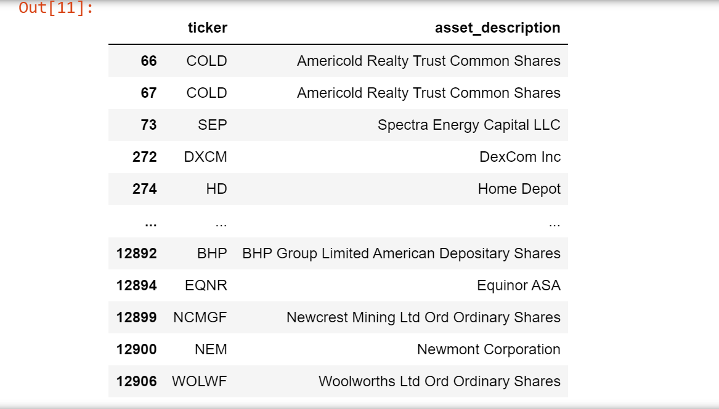
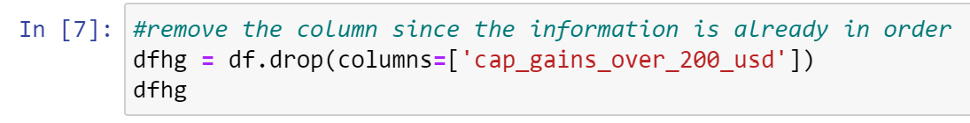
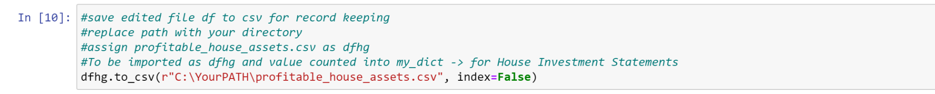
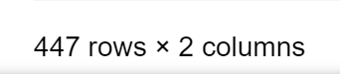
Code Data Mining for House Investments Features
house_Good_Investments_Sorted.csv
profitable_house_assets.csv
Notes:
Focused on investments that produced significant profitable gain
Dropped unnecessary columns - based on what the visualization and statements to be produced needed
The goal was to have a data frame that displayed the asset/ticker and the number of times it was on the list
Ideally would concate the senate data but the same info needed later for the visualizations were not included

Slide 13
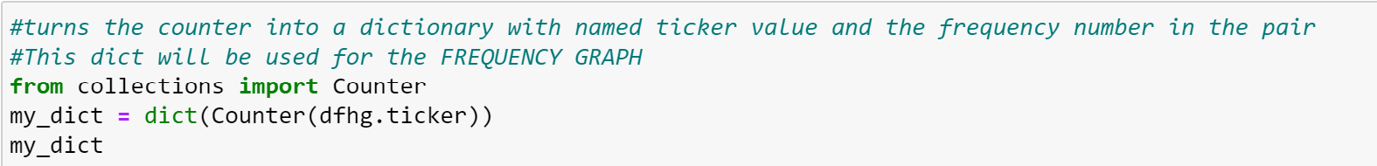
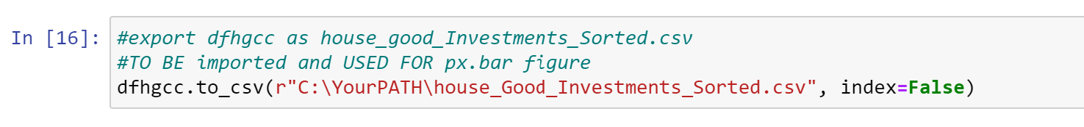
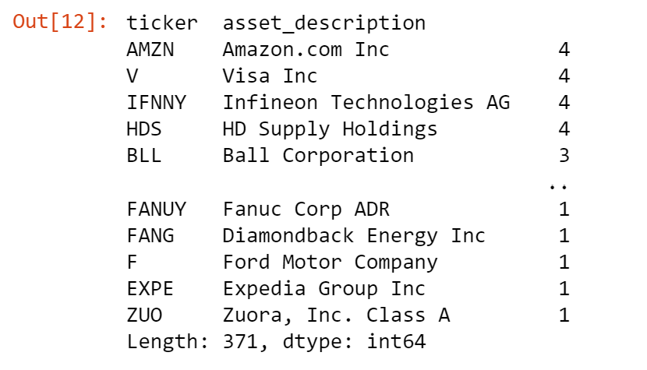
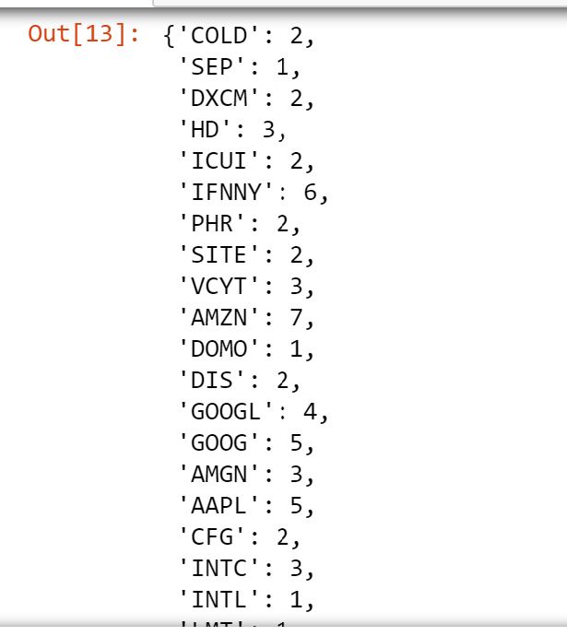
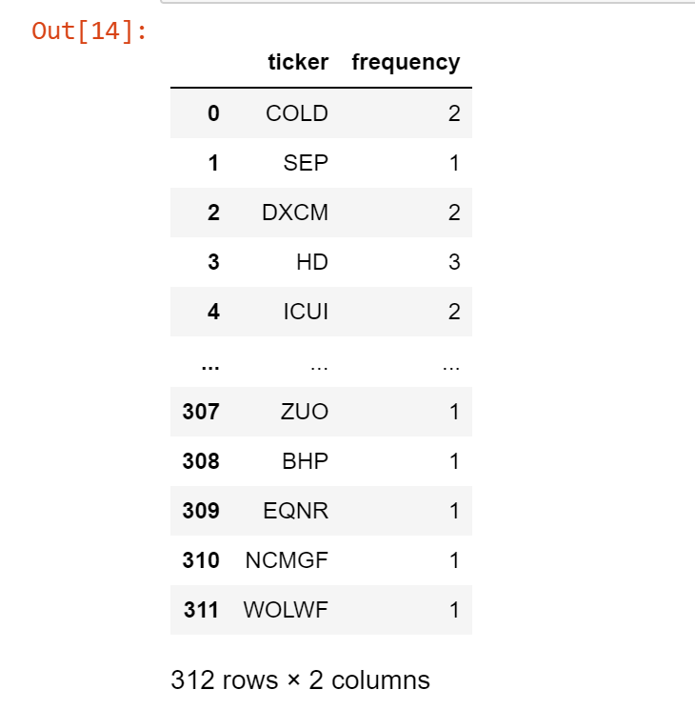
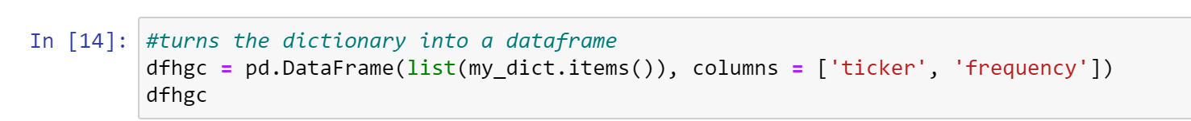
Code Data Mining for House Investments Features
dictionary
Notes:
Counts frequency of ticker values
Counter converted into dictionary with named ticker value and frequency number
Used the ticker because some of the same assets were listed with different formatting so it was not grouping them
In turning it into a dictionary every asset/firm that was the same was grouped and counted together.
Next was tp Convert the dictionary into its own dataframe and order the data in descending number order
The more frequent the asset/ticker appears on the list of profitable gains then the better of a buy it is

Slide 14
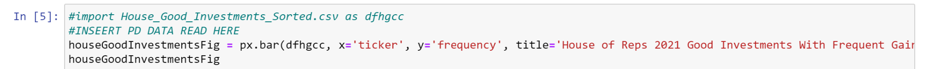
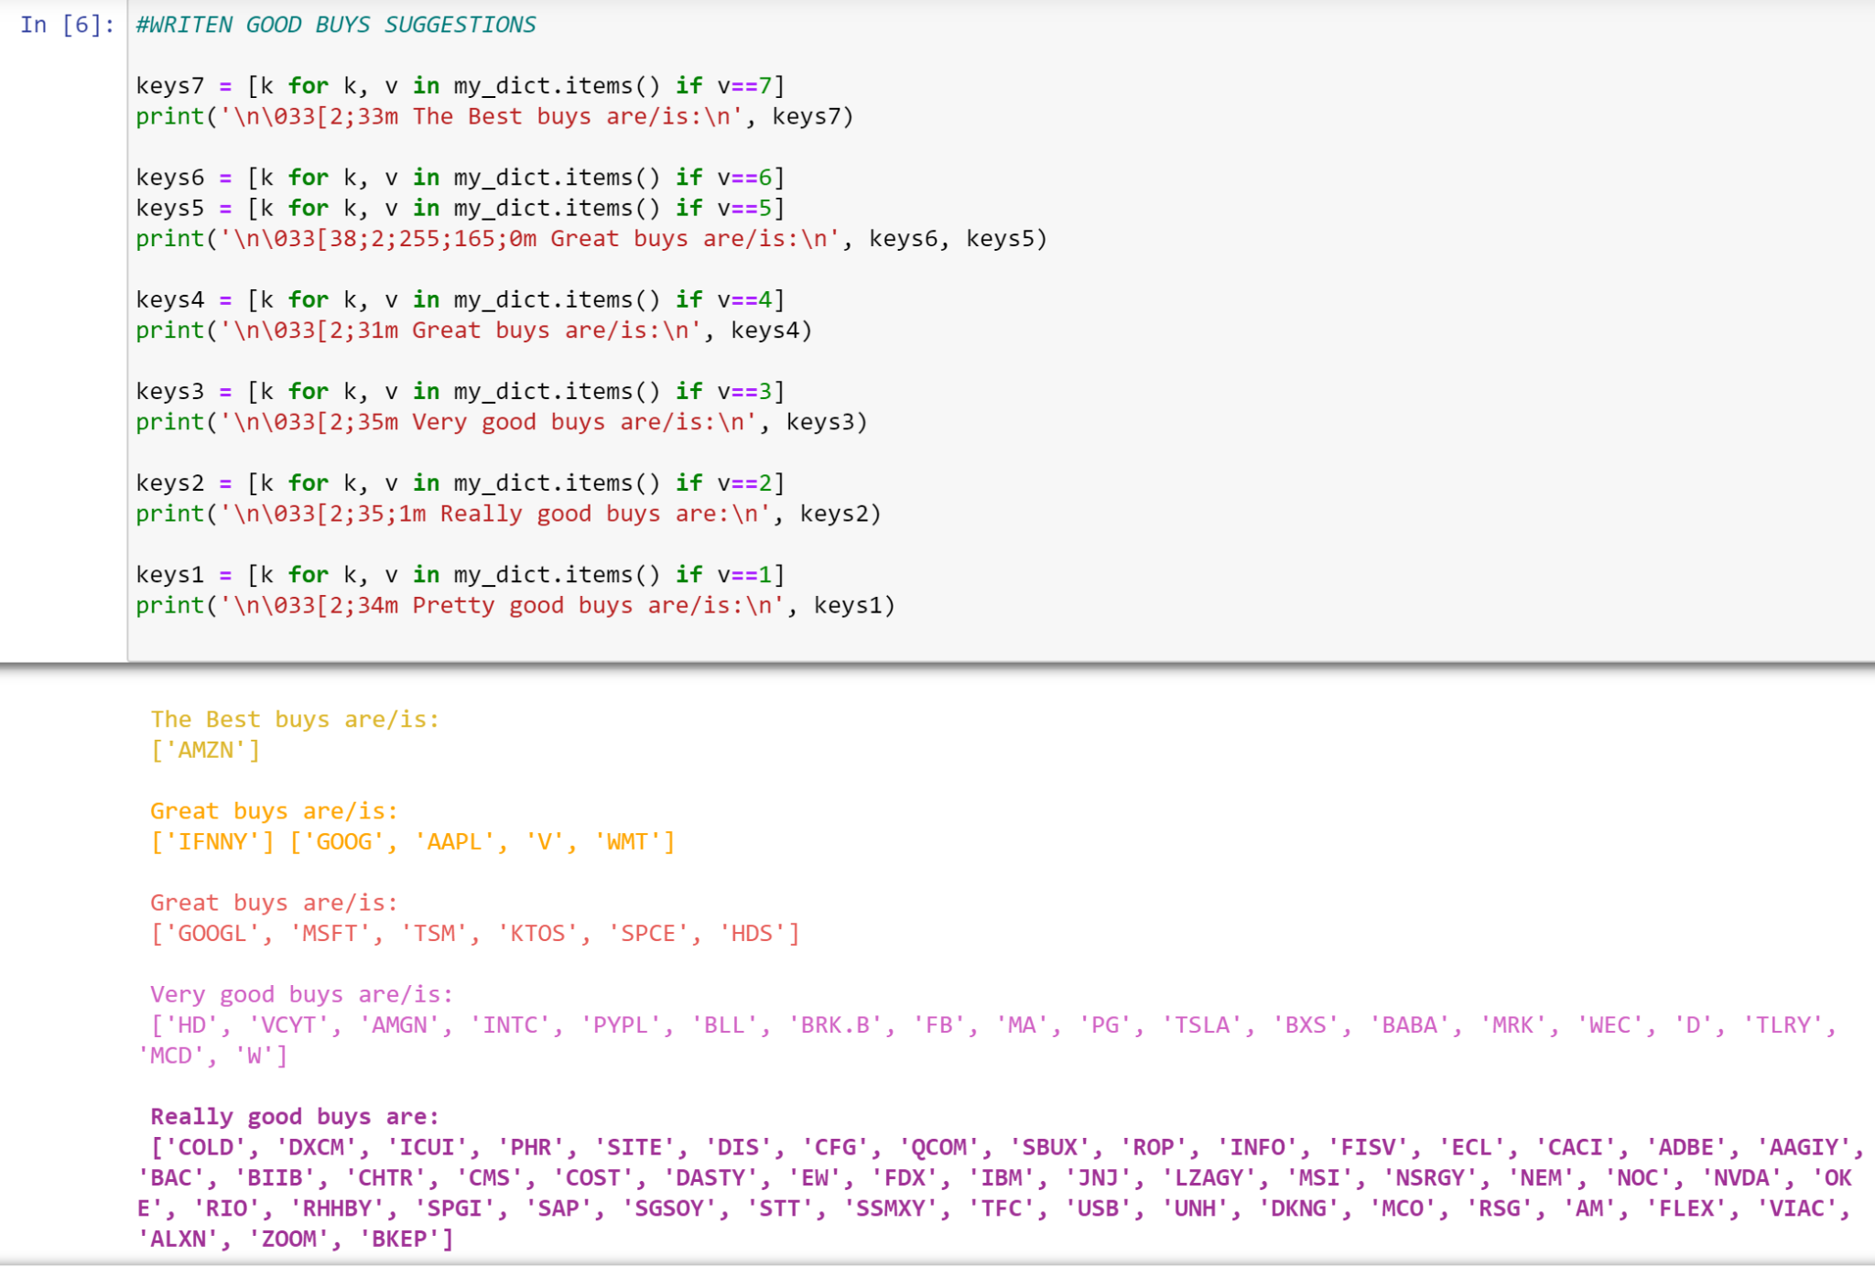
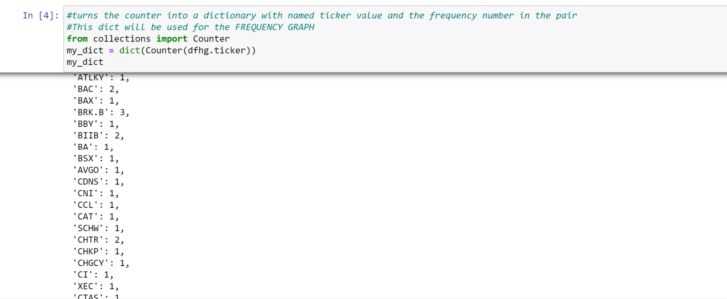
Code Viz & Statements for House Investments Features
house_Good_Investments_Sorted.csv
dictionary
color print
If statements
Notes:
Imported House Good Investments Sorted CSV as data frame
Plot in plotly express as a bar graph assigning the axis/labels to the column titles of the Dataframe
This produces the interactive visualization chart called House of Reps 2021 Good Investments with Frequent Gain
NEXT the same dictionary is called for the if statements that print in color based on the frequency value of the dictionary keys - which are the financial assets/tickers
This produces the House of Reps Ranked Best Buys Statements

Slide 15
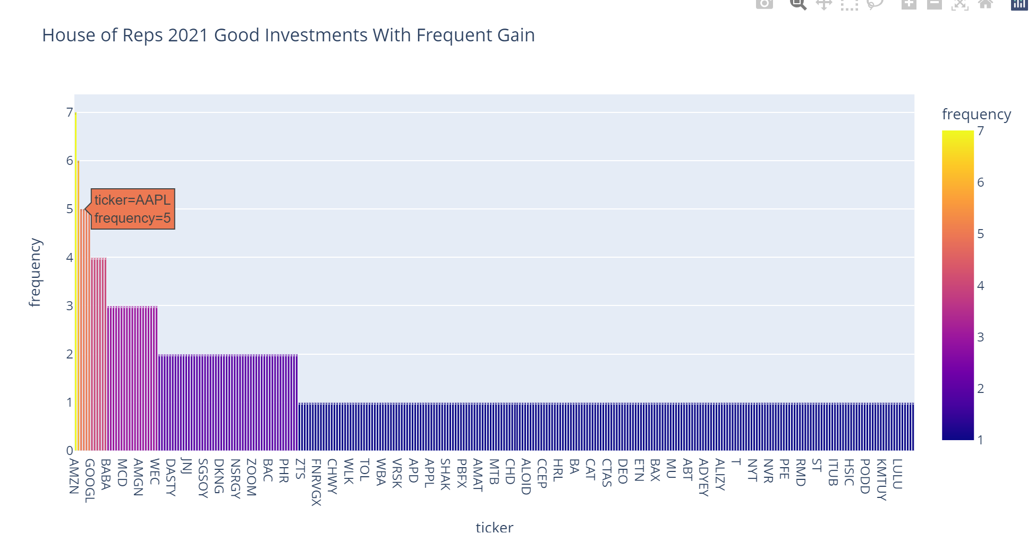
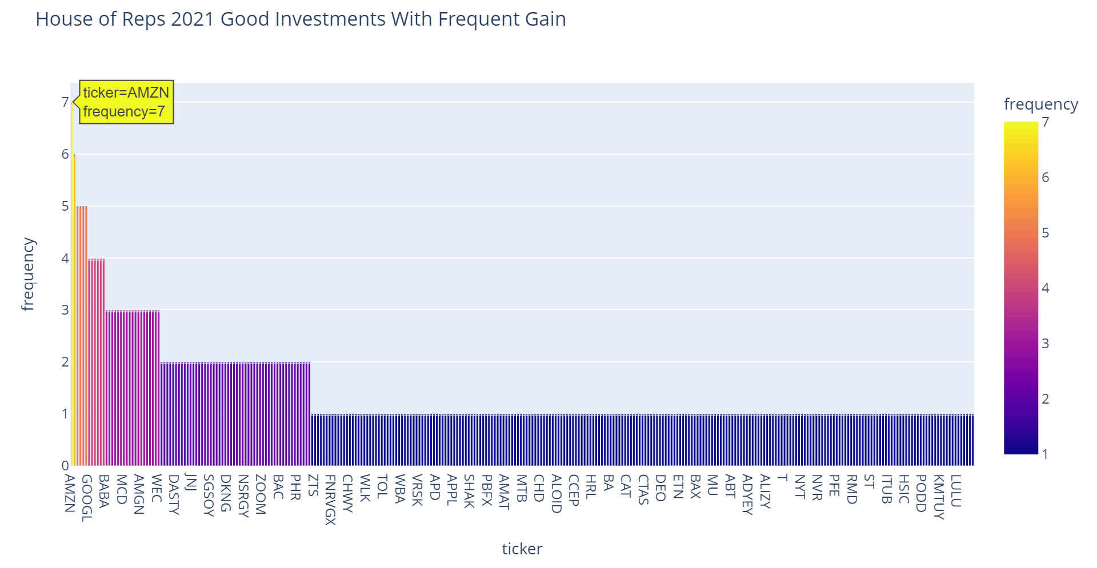
Code Demo for House Investments Features
Notes:
The produced interactive visualization chart : House of Reps 2021 Good Investments with Frequent Gain
by hovering pointer the user can gain the information within the tickers marker
Note that all ticker symbols included in the data are not labeled on chart so the interactive feature is key to the gaining of investment information

Slide 16
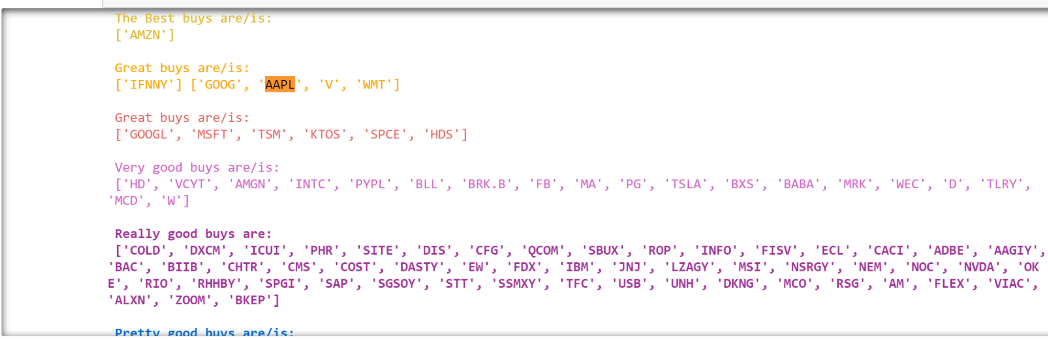

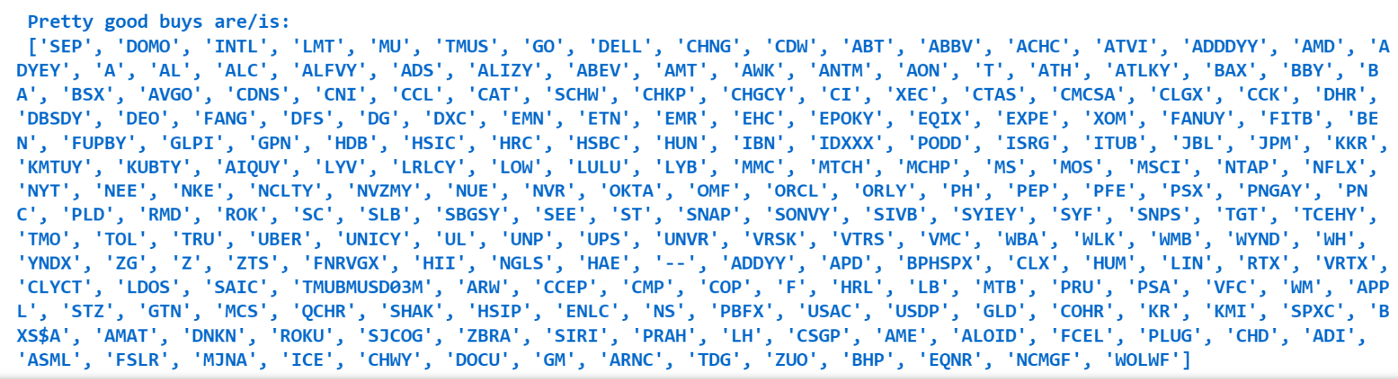
Code Demo for House Investments Features
Notes:
From the dictionary this House of Reps Ranked Best Buys Statements is produced
The statements are written in the form of a list
The grouping occurs by frequency and in order from best to ok.
The color coding also corresponds with the interactive graphs as they are joined information to be displayed on a the same Coattails page
A query call / search bar ideally would be used within the web page or simply ‘ctrl f’ to quickly sift through to find the users desired asset/ticker and to analyze placement/credential

Slide 17
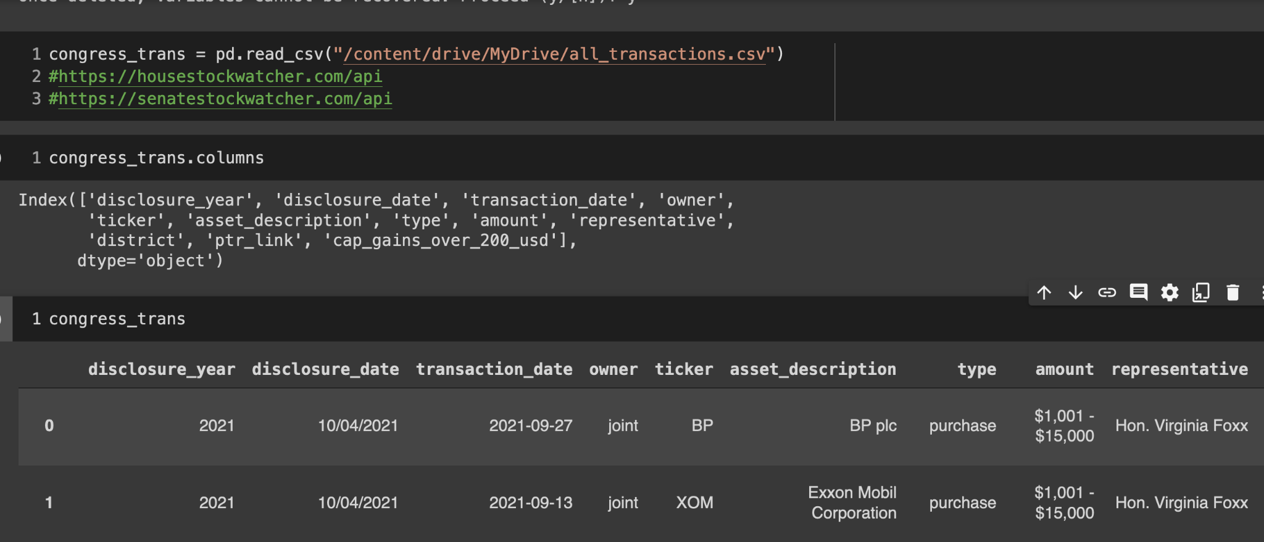
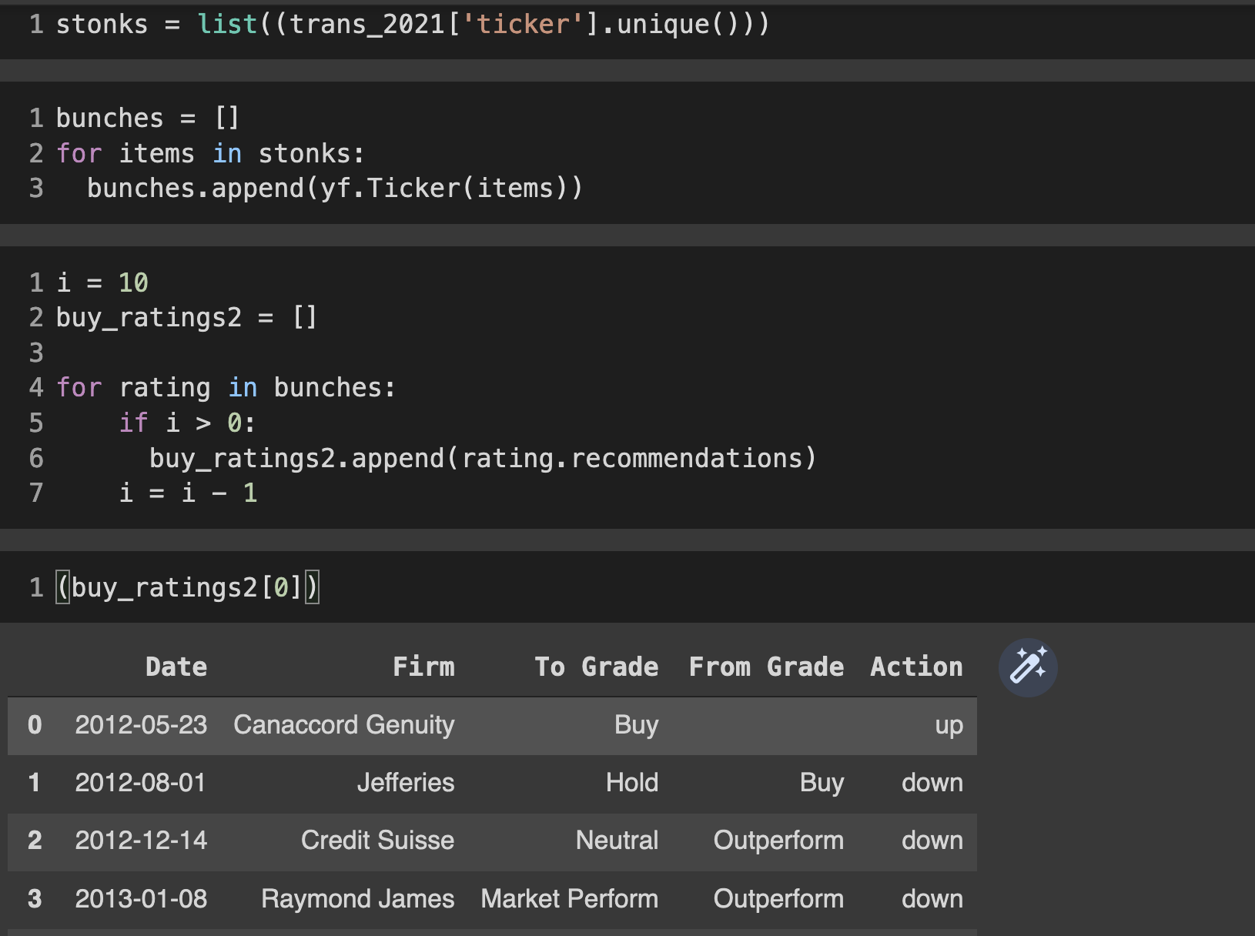
Recommender Cross Referencing

Slide 18
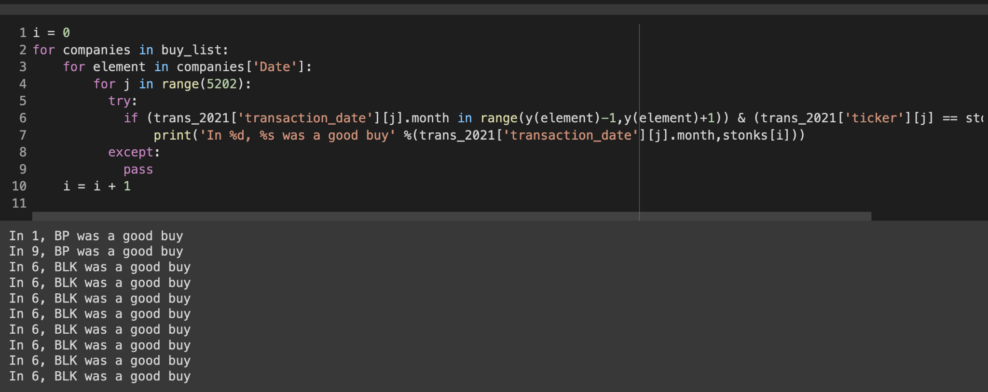
Recommender Cross Referencing(cont.)
(use user manual walkthrough screenshots/descriptions)

Slide 19
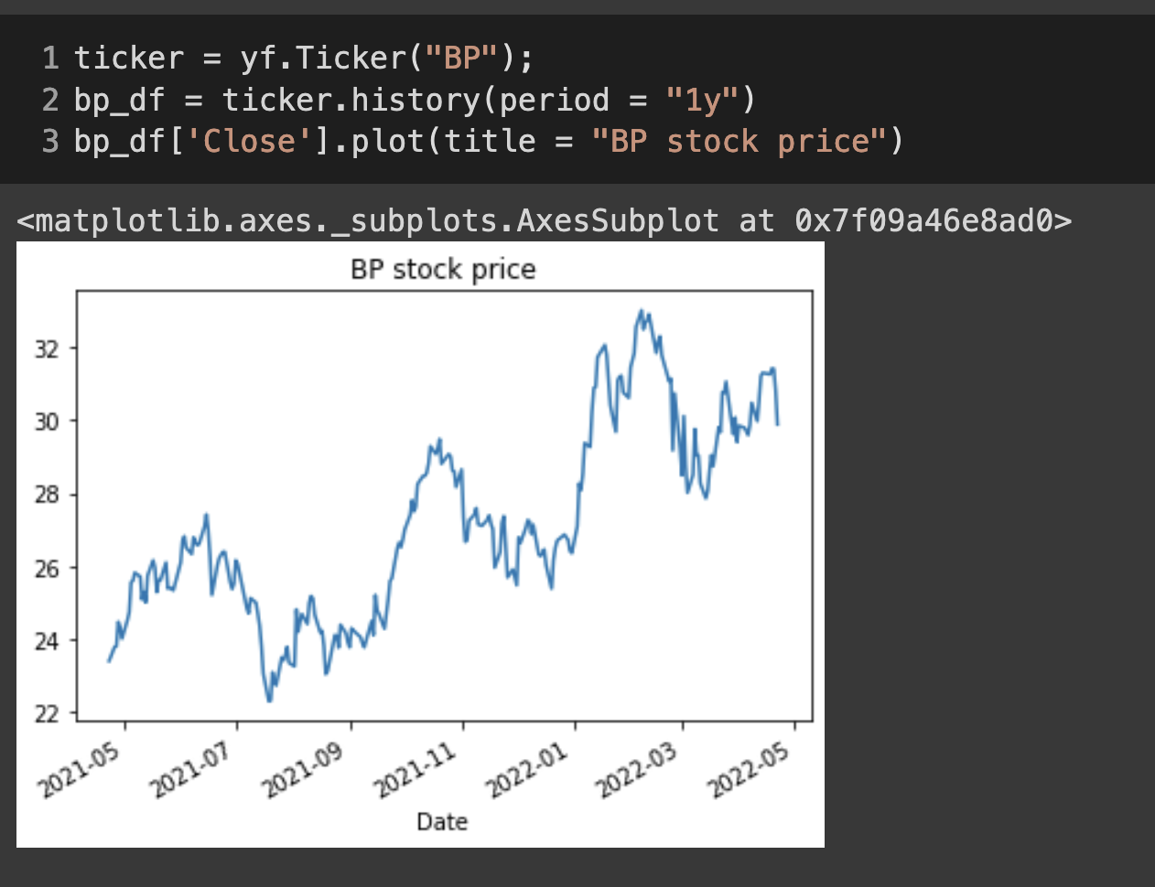
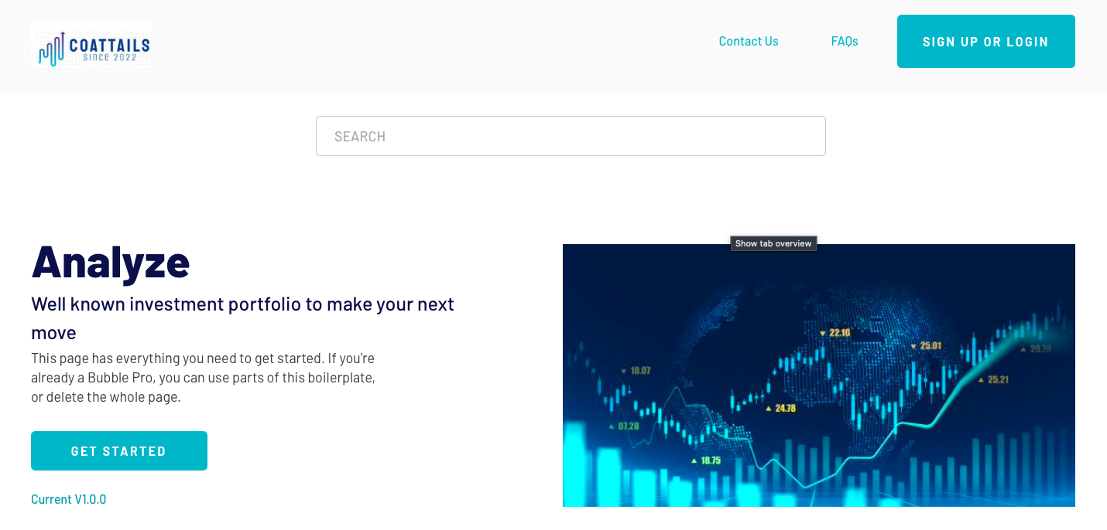
Recommender Cross Referencing(cont.)
(use user manual walkthrough screenshots/descriptions)

Slide 20
Website
(use user manual walkthrough screenshots/descriptions)

Slide 21
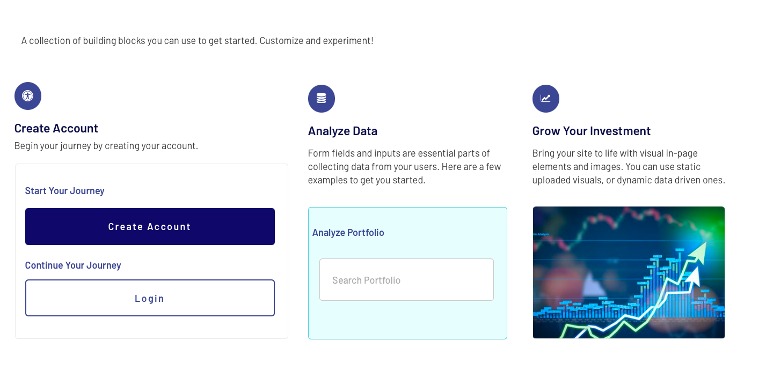
Website
(use user manual walkthrough screenshots/descriptions)

Slide 22
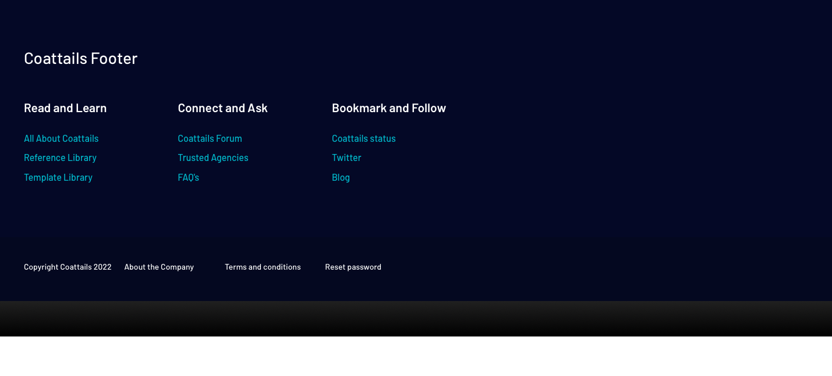
Website
(use user manual walkthrough screenshots/descriptions)

Slide 23
Thank you

